Slide 1

BUSINESS PLAN
Business plan
is a written document prepared by
entrepreneur that describes all the relevant external and internal elements involved in starting new venture. It is an integration of functional plans such as marketing, finance , manufacturing and human resource plan.
A business plan is a blue print of step by step process that would be followed to convert business idea into successful business venture.

Slide 2

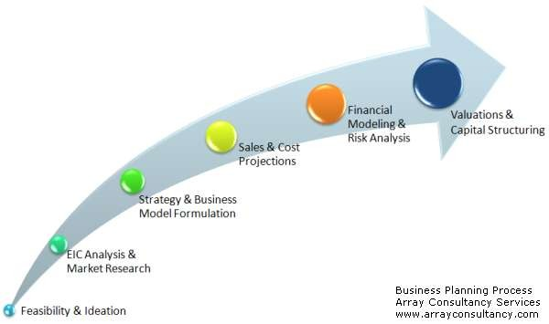

Slide 3

OBJECTIVE OR IMPORTANCE OF BUSINESS PLAN
To give direction to the vision formulated by the entrepreneur
To objectively evaluate the prospectus of business
To monitor the progress after implementing business plan
To persuade others to join business
To seek loans from financial institutions
To visualize concept in terms of market availability, organizational, operational, and financial feasibility
To guide entrepreneur in actual implementation of plan
To identify actual strength and weakness of plan

Slide 4

To identify challenges in terms of opportunities and threats from the external markets.
To clarify ideas and identify gaps in management information about their business, competitors and market.
To identify the resources that would be required to implement the plan
To document prospectus and venture.
ownership projected
arrangements, growth of the
future business

Slide 5









BUSINESS PLAN PROCESS
Idea generation
Environmental scanning
Feasibility analysis
Project report preparation
Evaluation, control and review

Slide 6

BUSINESS PLANNING PROCESS
Idea generation : is the first step in the business planning process. This step differentiates entrepreneur from usual business. An entrepreneur may come up with new business idea or may bring in value addition to existing product in the market. Sources of new idea for entrepreneurs are :
Consumers/ customers
Existing companies
Research and development
Employees
Dealers, retailers

Slide 7

Environmental scanning : once the entrepreneur is through the idea generation stage, next entrepreneur is required to conduct environmental scanning which includes analyzing external and internal environment that affects business idea.
1. External environment comprises of :
Socio cultural appraisal : it gives brief overview about the culture and tradition existing in society. It is comprised of values and beliefs of people which determines the acceptance of product by customer in the market.
Technological appraisal : it assess various technological options available to convert an idea to product. It also provides an brief overview about technological updation.

Slide 8

Economic appraisal : it assess the status of the society in terms of economic development, per capita income, national income, consumption pattern in the business.
Demographic appraisal : it assess the population pattern of given geographic area. Which includes sex, age profile, distribution etc.
Government appraisal : it assess the various
legislation, particular
policies, industry.
incentives formulated for Flexibility of these rues
determine ease for entrepreneur in terms of opening venture in particular area.

Slide 9

2. Internal environment :
Raw material : it refers to in terms of availability of raw material required for the process of production. If the material availability is at distance place and is very expensive then entrepreneur should give second thought to the same.
Production/ operation : it assess the availability of various machineries, equipments, tools and techniques that would be required for production.
Finance : it studies total requirement of finance in terms of start up expenses, fixed expenses, running expenses etc.
Market : refers to study on potential customer and target customers in market.
Human resource : refers to demand and supply of required human resource in market and estimation of expenses to be incurred on human resource.

Slide 10

Feasibility analysis : refers to conducting detailed analysis in relation to every aspect relevant to business and determining credibility of business.
Market analysis : is conducted to estimate the demand and market share for proposed product and service in future. Demand and market analysis is based on factors like consumption pattern, availability of substitute goods and services etc.
Technical and operational analysis : is to assess operational ability of proposed business enterprise. Technical or operational analysis collects data on following parameters :
Material availability
Material requirement planning
Plant location
Plant capacity
Machinery and equipment.

Slide 11

Marketing plan : lays down the strategies of marketing which can lead to success of business plan. Strategies are in terms of marketing mix which includes ( product, price, place, promotion ) which determines the potential demand of customers for product in the market.
Production plan / operational plan : production plan is drafted for manufacturing sector where as operation plan is designed for business into service sector. It comprises of strategies on parameters such as location layout, cost, availability of material, human resource etc.
Organizational plan : defines type of ownership pattern in company, sole trading concern, family business, private or public limited company etc.
Financial plan : financial plan indicates the requirement of proposed business enterprise. Which includes fund flow, cash flow statement, break even point, projected ratio, projected balance sheet.

Slide 12

Project report preparation : project report is a written document that describes step by step strategies involved in starting and running business.
Evaluation , control and review : as company operates in dynamic environment company has to monitor and review strategies and policies to stay in line with competition existing in market.

Slide 13

MARKET PLAN
Market plan refers to plan that describes market condition and strategy related to how products and services will be distributed, priced and promoted in market.
INDUSTRY ANALYSIS : prior to preparation of market plan entrepreneur are required to conduct industry analysis section of the business plan. Industry analysis provides information about national and local market that affection marketing operation of company. Industry analysis also involves collecting information about competitors which is available in form of secondary data by news papers, article, websites, catalogs, promotions, interview with distributors, customers etc.

Slide 14

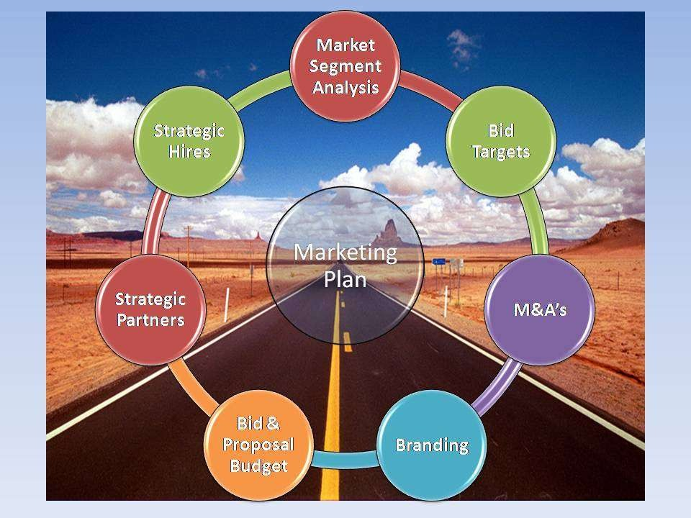
https://www.facebook.com/ialwaysthinkprettythin
gs

Slide 15





STEPS INVOLVED IN MARKET RESEARCH
2. Gathering data from secondary sources
3. Gathering data from primary sources
4. Analyzing and
interpreting the result.
1. Define purpose and
objective

Slide 16

STEPS IN MARKETING RESEARCH
Defining the purpose or objective : it refers to entrepreneur should be clear nature of information required by the business, sources through which required data will be collected, whether required data will be from primary or secondary source of information.
Gathering data from secondary sources : secondary source of information refers to data available about competitors strategy and their position in the market. Required information on competitors is available through magazines, new papers, libraries etc.

Slide 17

Gathering information from primary source : primary data required for market research is collected through methods such as observation, networking, interviewing, focus group, exhibition etc.
Analyzing and interpreting results : results should be evaluated and interpreted depending on the objective of research process. Summarizing results will
provide in preliminary market position and
insights about competitors
competitive
their image in
environment.

Slide 18

CHARACTERISTICS/ IMPORTANCE OF MARKET PLAN
it should provide strategy for accomplishing the company mission and goal.
It must provide for the use of existing resources and allocation of all equipment , financial resources, human resources in company.
It should provide for continuity so that each annual marketing plan can successfully meet long term goals and objectives of company.
It should be simple and specific in nature so as to provide appropriate road may in terms of planning market strategy for company.
It should focus on criteria to be evaluated to assess market success of the company.

Slide 19










MARKET PLAN
DEFINING THE BUSINESS SITUATION
DEFINING THE TARGET MARKET ( OPPORTUNITIES AND THREATS )
CONSIDERING STRENGHTS AND WEAKNESS ESTABLISHING GOALS AND OBJECTIVES
DEFINING MARKET STRATEGY AND ACTION PROGRAM
PRICING DISTRIBUTION PROMOTION
PRODUCT
MARKET STRATEGY
BUDGETING MARKET STRATEGY IMPLEMENTATION OF MARKET PLAN
https:^{M}//^{O}ww^{N}w^{IT}.f^{O}ac^{R}e^{I}b^{N}o^{G}ok^{P}.^{R}co^{O}m^{G}/^{R}ia^{E}l^{S}w^{S}ay^{O}st^{F}hi^{M}nk^{A}p^{R}re^{K}t^{E}ty^{T}t^{I}h^{N}in^{G ACTIONS}
gs

Slide 20

STEPS IN PREPARING MARKET PLAN
Defining business situation refers to understand past and present business achievements of new venture. It give basic insight about scenario persisting in market, response of customers to new venture in market, and helps in predicting customer acceptance of company product in market.
Defining target market : target market refers to group of potential customers towards which venture aims its market plan. Knowledge of target market will provide basis for determining appropriate market action strategy to meet needs of customers. Target market also includes market segmentation which involves process of dividing market into definable and measurable groups for purpose of targeting market strategy.

Slide 21

Considering strength and weakness : strength of business refers to core areas which company is specialized in which may be abundance experience of company in similar area of business and weakness may be in terms of production capability, or layout which permits limited space for equipment and operation.
Establishing goals and objectives : marketing goals of the company should be clear and specific in nature as it has to clearly indicate about nature of product, target customers ,sales promotion , advertising support etc.

Slide 22

5. Defining market strategy and action program : it refers to specific activities outlined to meet the venture , business plan objectives and goals.
Product and service : indicates description of product or service to be marketed in the new venture.
Pricing : refers to price to be charged for product in market before which company is required to consider various aspects such as cost, margin , competition etc.
Distribution : refers to means through which product will be made available to customer in market which involves decision relating to nature of product, distribution channel, middlemen etc.
Promotion : refers to various channels through which entrepreneur will advertise company product to customers in market.

Slide 23

6. Marketing strategy : it involves understanding the nature of product and accordingly planning in for
marketing consumer
product. Entrepreneur may product directly to customers
market while
manufacturing products are to be sold to business than customers in market. Dell computers markets its products both to customers as well as business people.
7. Budgeting marketing strategy : after drafting marketing plan entrepreneur is required to estimate total expenses to be incurred in process of implementing market plan. Expense of marketing plan should be in line with planned expense of entrepreneur.

Slide 24

Implementation of market plan : market plan should be implemented in the company , should be informed to the workforce involved in marketing activity , it acts as guiding element to direct on strategies which will make marketing process effective.
Marketing progress of marketing actions : marketing of plan involves tracking specific results of marketing effort. Sales data of product, data gathered by market survey are few methods of monitoring progress of market plan.

Slide 25

PRODUCTION PLAN
Production plan is the process of converting the input into output through a conversion process. The inputs are in the form of land, labour, raw material, machinery, capital and information. Transformation takes place through machinery in manufacturing unit and through employees skills in service sector.

Slide 26









Dimension of production plan
 |  |  | Monitoring | QMS | TQM | Budgeting
Plant | Plant | Inventory | stock
location | layout | mgmt |  |  |  | production
 |  |  |  |  |  | plan

Slide 27

DIMENSION TO BE COVERED WHILE DRAFTING PRODUCTION OR OPERATION PLAN
Plant location : refers to geographic location were the infrastructure of company will be built and operations of the company will take place. Following aspects should be taken care of before choosing plant location
:
Vicinity to raw materials
Availability of raw materials
Availability of labour
Proximity to market
Climate condition
Cost of location
Tax, subsidies and loans

Slide 28

Plant layout : is pattern in which space would be arranged in order to utilize the machinery, equipment, and manpower. Effective designing of plant layout reduces unnecessary movement of employees and helps in effective utilization of time and resources in company. Variables to be considered while planning plan layout :
Space is utilized properly
Proper light and ventilation in all the area of premises
Ensure smooth flow of operation
Supervision can be carried out in smooth manner
There are provision for emergency exit
There is flexibility to introduce changes in future

Slide 29

Inventory management : inventory management refers to maintaining inventory in form of raw materials more than production requirement to meet future un predicted obligations.
Monitoring stock turn and coverage : monitoring individual stock items will identify fast and slow movers depending on the industry.
Quality management system : quality management refers to maintaining quality in terms of product produced in company. As customers these days are getting conscious about quality day by day maintaining quality standards in product will help in building company image and also build customer loyalty towards company.

Slide 30

Total quality management : management focuses on
perceptual problems monitoring quality etc.
Budgeting
enhancement through prevention of
and errors. It requires continuous and control
process, performance and
production plan : depending on the
selling price per quantity, projected cost of production at each quantity can be estimated. The amount of production is dependent on the capacity of production unit.

Slide 31

ORGANIZATIONAL PLAN
Organizational plan involves deciding
form of
ownership that entrepreneur intends to enter. Nature of planning , organizing, leading and controlling will be determined by nature of business or form of ownership.

Slide 32















DEVELOPING MANAGEMENT TEAM
LEGAL FORM OF BUSINESS
ownership
Liability of owner
Cost
Continuity
Transferabilit y of interest
Capital requirement
Management control
Raising capital
TAX ATTRIBUTES OF FORMS OF BUSINESS
DESIGNING THE ORGANIZATION
BUILDING MANAGEMENT TEAM AND ORGANIZATION CULTTURE
ROLE OF BOARD OF DIRECTORS
BOARD OF ADVISORS

Slide 33

STEPS IN ORGANIZATIONAL PLAN
Developing management team : refers to set of employees employed in the company who are in charge of managing the activities on the operating part of organization.
Legal form of organization : refers to composition and legal existence of business. Business may be proprietorship, partnership or corporation form of business. Three legal forms of business are :
Corporation is legal entity that is run by stock holders having limited liability. It is regulated by the statute and is treated as separate legal entity for liability and tax purpose.
Proprietorship : is form of business with single owner who has unlimited liability, controls all decisions, and receives profit.
Partnership : two or more individuals having unlimited liability who have pooled resources to own a business.

Slide 34

Ownership : it refers to pattern of investment and control of owners in company, which includes conditions relating to sharing of profit and loss in business.
Liability of owners : of business covers two aspect either members of business will have limited or unlimited liability depending on legal form of business agreed by partners.
Costs of starting business: refers to expenses incurred in starting the business and proportion of contribution from every member of business or sources through which required finance of business will be raised.
Continuity of business : refers to question on who will take over business operations in future and what will be members role in coming future.
https://www.facebook.com/ialwaysthinkprettythin
gs

Slide 35

Transferability of interest : entrepreneur will have two options in relation to transferability of interest owner may transfer his interest after assessing credibility of member in business or may sell interest with his own wish.
Capital requirement : refers to amount of capital required to start up business venture, sources through which required finance for company will be obtained, what will be contribution of members or the owner towards business.
Management control : it refers pattern in which control of business will be hand of individual person or members in business. It also comprises of power of members in terms of decision making, guiding business activity in company.
https://www.facebook.com/ialwaysthinkprettythin
gs

Slide 36

Distribution of profit and loss : profit of the firm may be shared as per the terms and conditions agreed by the members of business, loss or liability of individual depends on nature of business agreement of partner with the business.
Tax attributes for forms of business : tax advantage and disadvantage will vary in accordance with form of business. In proprietorship and partnership profit and loss of business is considered same as that of individual as in corporation as business is treated as separate entity tax is laid on business and earning of individual separately.
https://www.facebook.com/ialwaysthinkprettythin
gs

Slide 37

Designing the organization : it comprises of formal and explicit indication to the members of the organization as though what is expected from them. These expectation are group in following area :
Organization structure refers to task, responsibility and accountability of every member in the business.
Planning, measurement and evaluation of schemes communicate goals and strategies to attain desired goals in business.
Rewards : forms of rewards and yardstick based on which employees will be rewarded in company.
Selection criteria refers to guidelines for selecting employees in company.
Training : refers to determining skill requirement of employees in company and accordingly design training program for employees in company.
https://www.facebook.com/ialwaysthinkprettythin
gs

Slide 38

Building the management team : this process involves to see that strategy of business should be in line with objective of the company, management team of the company should be role model for employees in company and accordingly plan and guide employees towards organization goal attainment. Management team of the company should be flexible to try new techniques and innovation in the company. Management team should focus on hiring efficient employees in company and develop core values which guide and regulate employees behavior and attitude in company.
https://www.facebook.com/ialwaysthinkprettythin
gs

Slide 39

Role of board of directors : board of directors in the company are required to review operating and capital budget, developing long term strategic plan for growth and expansion, supporting day to day activities, resolving conflicts among owners or shareholders, ensure proper use of assets, developing network source of information for entrepreneurs.
Board of advisors and organization : board of advisors are not permanent employees of the company. They are set of expertise who guide business in terms of management and technical issues in company.
( this study material is only for your internal i will mail detailed notes later )
https://www.facebook.com/ialwaysthinkprettythin
gs

Slide 40

FINANCIAL PLAN
it studies total requirement of finance in terms of start up expenses, fixed expenses, running expenses etc. financial plan indicates the requirement of proposed business enterprise. Which includes fund flow, cash flow statement, break even point, projected ratio, projected balance sheet.
https://www.facebook.com/ialwaysthinkprettythin
gs

Slide 41

C O M P O E N E T OF F
I N A N C I A L
PLAN
OPERATING AND CAPITAL BUDGET
PRO FORMA OF INCOME STATEMENT
PRO FORMA OF CASH FLOW
PRO FORMA BALANCE SHEET
BREAK EVEN ANALYSIS
PRO FORMA OF SOURCES AND APPLICATION OF FUND
https://www.facebook.com/ialwaysthinkprettythin
gs

Slide 42

Operating and capital budget : before developing pro forma income statement , entrepreneur should prepare operating and capital budgets. If entrepreneur is running sole trading concern then he is responsible for budgeting decision and if it is partnership or other form of legal concern then budgeting decisions are to be taken by assigned member of business.
Pro forma of income statement : refers to projected net profit calculated from projected revenues minus projected costs and expenses. It should comprise of sales on monthly basis, insight on operating expenses, salaries and wages should highlight on total number of employees employed in company.

Slide 43

Proforma of cash flow : refers to projected cash available calculated from projected cash accumulation minus projected cash dismemberment. It is result of difference between actual cash receipts and cash payments. Cash flow takes place in company only when payments are made or received.
Proforma of balance sheet : summarizes the projected assets, liabilities, and net worth of new venture. Balance sheet represents the position of the business at end of year. Assets represent the items that are owned or available to be used in venture operation.

Slide 44

Break even analysis : entrepreneur in initial stage is required to know when profit may be achieved which will help him understand financial potential of tart up business. BEA is useful technique to analyze how many units have been sold or how much sales order have to be achieved in order to break even. Break even is volume of sales where venture neither makes profit nor loss.
Proforma for sources and application of funds : summarizes projected source of fund available to the venture and how these funds will be distributed.

Slide 45

CONTENTS OF PROJECT REPORT
Cover page : page of the project report should contain the title of the project, name, address so that the readers of the report can easily contact entrepreneur relating to queries of report.
Table of contents : table of content are compiled after the main body of the project report is finalized. Topics covered in the project report along with the page number should be mentioned in the project report.
Executive summary : should be written after the completion of project report as it gives brief gist of project. Length of the executive summary should not exceed more than two pages.

Slide 46

Company information and industry : here they should explain the ownership form of the company, which should contain the reason for venturing into the proposed business plan, how do you plan to satisfy the needs and expectation of the potential customers and existing competitors in industry. It should also include SWOT analysis of company.
Technical plan : in this part of the report the key aspect analyzed during the technical feasibility of the report should be highlighted. The choice of the product and service to be offered should be justified. Report should be able to explain how the product of the company is creative and innovative from the existing product in the market.
https://www.facebook.com/ialwaysthinkprettythin
gs

Slide 47

Marketing plan : this aspect of the product should focus on the industry and market feasibility conducted at earlier stage. It should describe about the pricing policy, findings of market research, how large is the market for the product to be offered by the company, details about marketing strategy adopted by the company to promote the product, target customers company is focusing on.
Operations plan : it describes about the manufacturing and service delivery process to be utilized for production of chosen product and service. It should explain about the innovation brought in the process of production which makes it better when compared to existing competitors. It should also focus on the location, availability of resources required for production.
https://www.facebook.com/ialwaysthinkprettythin
gs

Slide 48

Organizational plan : it gives information about the management team who are part of the company. It focuses on the management and technical skills possessed by the employees in company and how it will prove to be beneficial for the work process to be carried in the company. It should highlight as though why even after possessing such efficient skills they preferred joining your organization.
Project timeline : this chapter explain about the network diagram which explains about the time duration required for the project. Diagram explains about the various activities in the project, which are sequentially organized and the time duration required for the execution of the project is arrived by estimating time required for completion of every activity for the formation and later process of the company.
https://www.facebook.com/ialwaysthinkprettythin
gs

Slide 49

Critical risk and assumption : it explain about the various assumption made during the formation of the company E.g. rather then considering the previous sales forecast for similar product to be offered by the company, the organization may have gone in for expert advise, their may be various risks related to the product and kind of service company is planning to offer in the market all these details should be highlighted in this part of the report.
Social plan : it explains about how company project will
benefit the society. It should highlight how company will
generate employment opportunities, lead to skill
of goods and
development of local people, provision
services to be provided to the local people, utilization of local resources etc. It should also include various help provided by the financial agencies and government to start SSI in country.
https://www.facebook.com/ialwaysthinkprettythin
gs

Slide 50

Exit strategy : this is the negative aspect of the business but the company should explain how they would close down the business if the company is not able to earn the expected profitability, the investors will be keen to know as though how their investment can be recovered in such situation.
Financial plan : it is important part of the report which will contain brief content all the sections with numbers in monetary terms. It explain about the financial composition of the company, various sources through which company has raised required finance, total expenditure incurred by the company which will be effectively explained through the means of break even analysis and ratio analysis in the company financial report.
https://www.facebook.com/ialwaysthinkprettythin
gs

Slide 51

Conclusion : this summarizes the key aspect of the report in concise manner. It should end the report on a positive note so that the readers develop positive image about the report.
Appendices : it contains conclusion part of the report and supplement data which is important part for the report but cannot be included in the initial topics of the report.
https://www.facebook.com/ialwaysthinkprettythin
gs

Slide 52
THANK YOU

